Slide 1
Making maps in Shiny
Class 10

Slide 2
Next Week
Install these packages for next week!
httr
jsonlite
purrr
tibble

Slide 3
Agenda
Reactive Q&A
Reactive Spatial Data
renderLeaflet()
Leaflet Proxy
Remove/Clear

Slide 4
Reactivity
in space

Slide 5
Not much has changed
Spatial DataFrame can be subset
Not easily piped
For some: ☹ Others: ☺

Slide 6
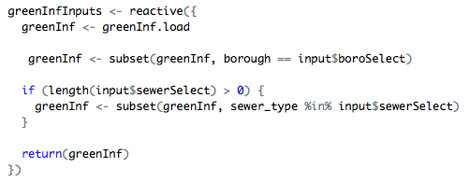
Reactive Spatial Data Example

Slide 7
The Easy Road
But ultimately harder on your server and requires more loading time

Slide 8
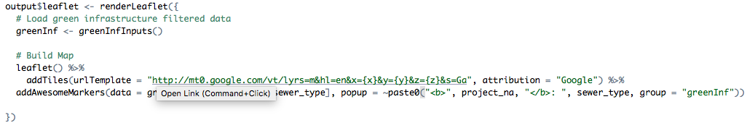
pipe in the reactive data and then Build your leaflet map

Slide 9
Pros and Cons
Re-zooms the map to the selected data each time a selection is changed
You don’t have to use observers or figure out how leafletProxy() works
User options like layerControls etc will reset every time someone changes one of your filters
On a smaller machine this processing will tax the server a bit
Re-zooms the map to the selected data each time a selection is changed

Slide 10
Shiny Proxy

Slide 11

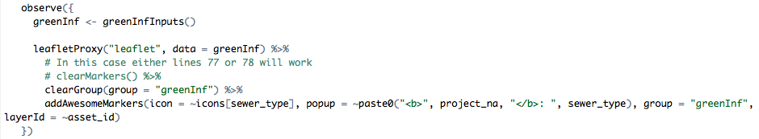
Build an empty make and then update it with an observer

Slide 12
Pros and Cons
Faster than rebuilding the entire map each time
User controls stay consistent throughout
You have to write an observer to re-zoom the map
You can do fun user input based things
Doesn’t re-zoom the map each time the user changes a selection
Requires an understanding of how observe() and leafletProxy() work

Slide 13
Observer functions
Observe works much like reactive except they change things permanently.
For example:
Input updates
notifications
shinyjs things such as disable/enabling buttons
A leaflet map

Slide 14
Leaflet provides inputs
In all of these examples “leaflet” is whatever you called your (ie: output$leaflet)
input$leaflet_center (lat, lng)
input$leaflet_zoom (numeric)
input$leaflet_bounds$ (north, east, south, west)
input$leaflet_marker_mouseout$ (id, group, lat, lng)
input$leaflet_marker_click$ (id, group, lat, lng)
input$leaflet_groups (list)

Slide 15
Clear versus Remove
clear will remove everything of a certain type, like shapes, markers, clusters, controls or groups
remove will remove thinks based off of their layerId()

Slide 16
Example of clear

Slide 17
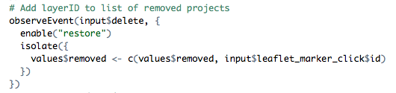
Remove example

Slide 18
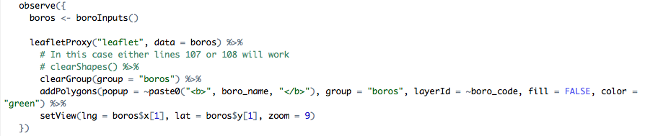
Recreating the zoom effect with setView()

Slide 19
Let’s look at some live examples

